Slide 1
Model Tuning and AWS Predictive Models

Slide 2
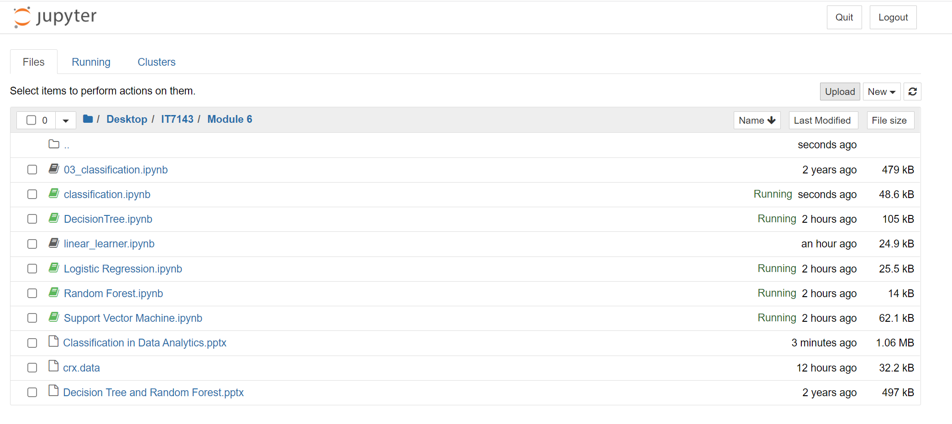
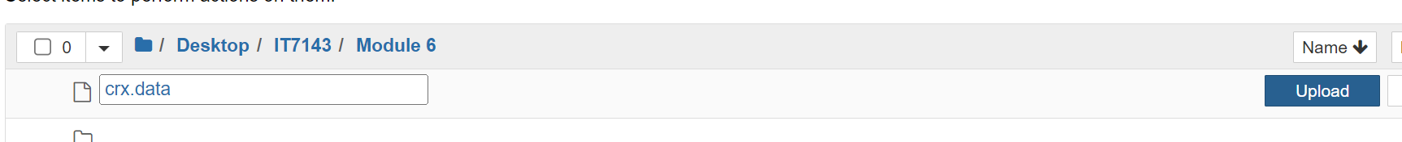
Uploading to SageMaker Notebook
You need to upload the data, the sample notebooks, and the sagemaker_models.py file to the server as follows
Start the SageMaker Jupyter like the tutorial in Module 6
When the Jupyter Environment finishes starting up, open Jupyter GUI
Click on Upload. You will be prompted to select the files. Do not forget to click on the Upload button for each individual file

Slide 3
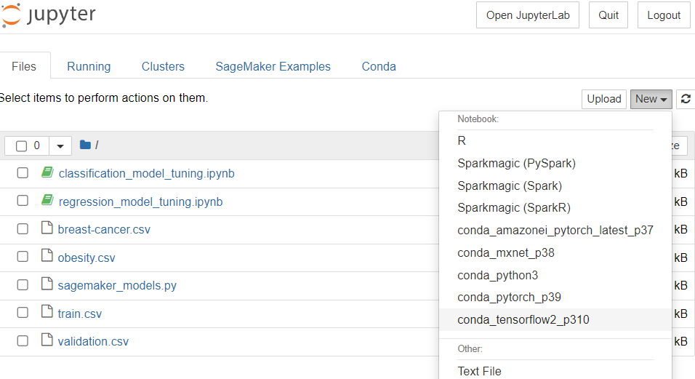
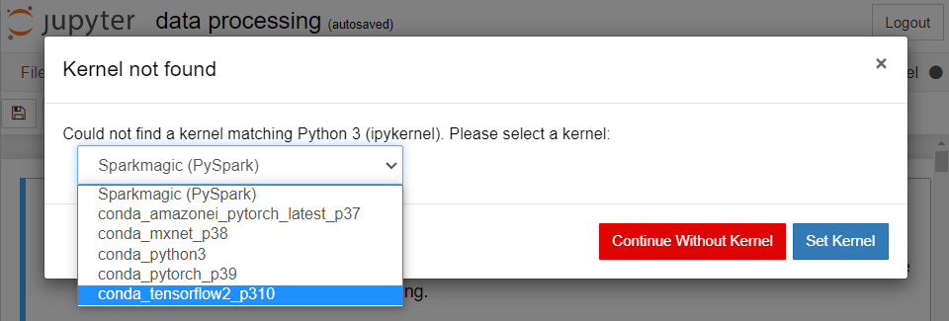
Setting Kernel
When you first create or open a notebook (downloaded from D2L), you will be asked to choose a kernel
Always choose conda_tensorflow2_p310

Slide 4
Model Tuning

Slide 5
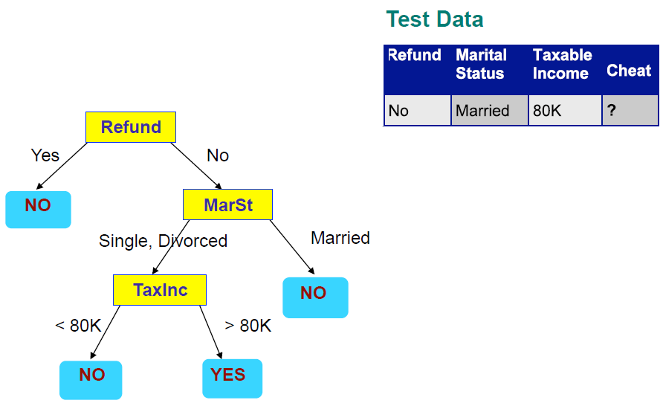
Decision Tree Revisited
Recall, a decision tree is a flow-chart-like model
To make decision
Start from the root node (the first node with no predecessors – nodes that lead to it)
Apply input data to the branch conditions at each node to reach a leaf node (nodes with no successors – nodes that branch from it)
The label at the leaf node is the predicted value of the target

Slide 6
Decision Tree Structures
Decision trees are not unique in a training dataset – there are multiple tree structures that can be learned
Example: the Breast Cancer data
Input features include Clump Thickness, Uniformity of Cell Size, Uniformity of Cell Shape, Marginal Adhesion, Single Epithelial Cell Size, Bare Nuclei, Bland Chromatin, Normal Nucleoli, Mitoses
Target: binary target, whether the clump is malignant (1) or benign (0)
We can build different decision trees on this data to predict if a clump is malignant (1) or benign(0)
Examples on next slide

Slide 7
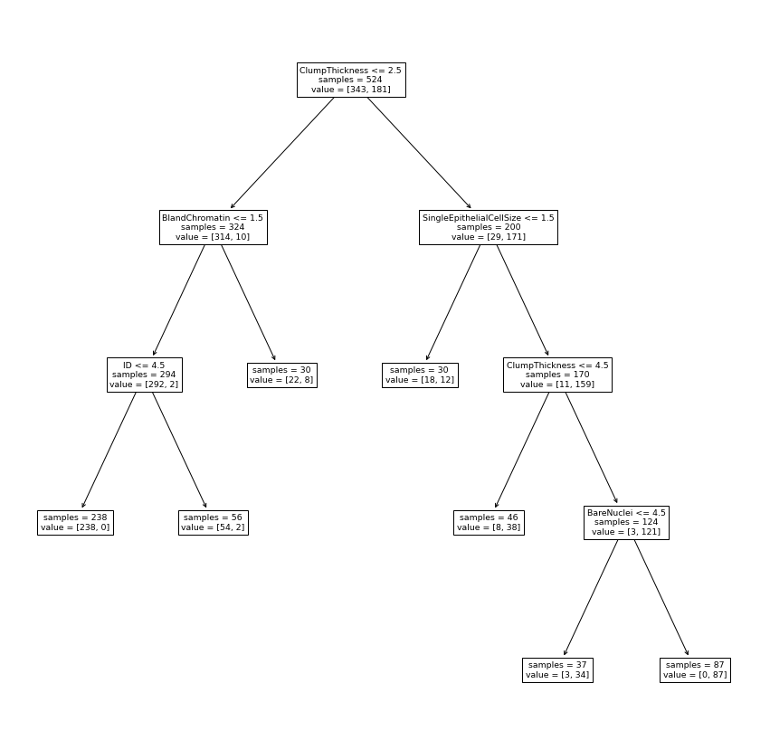
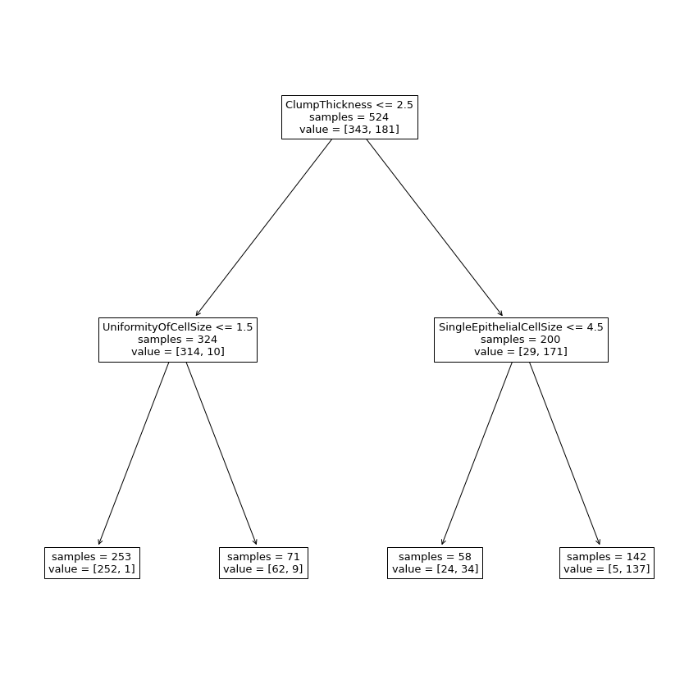
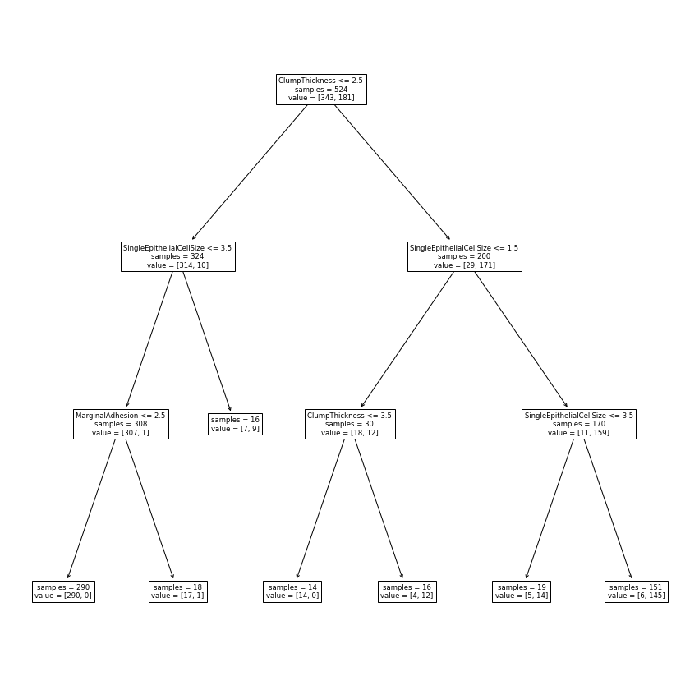
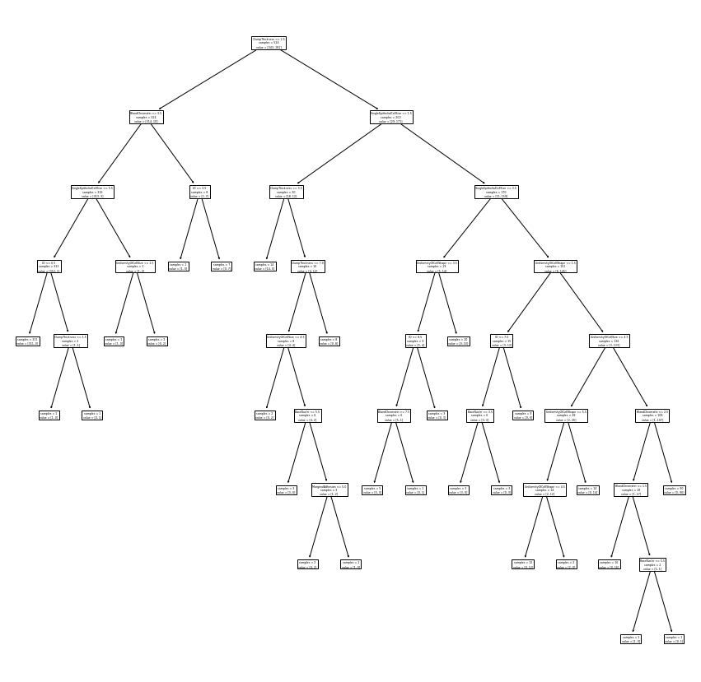
Different Decision Trees on the same Breast Cancer Data
Which tree to use?
How to choose a best tree for this data?

Slide 8

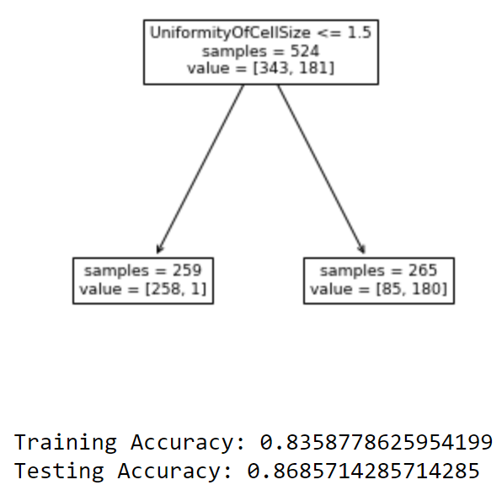
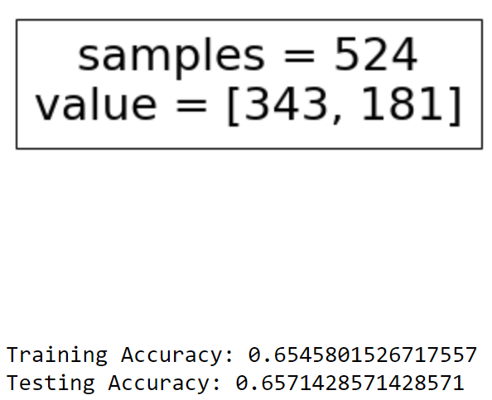
Hyperparameters
Root node
Are “metadata” of a model
For example: decision tree
Max depth: maximum depth (number of branches from the root node to the furthest leaf node) a tree can form
Minimum samples at split: minimum number of instances at a node for it to be eligible to form a split (have branches)
Minimum samples at leaf: minimum number of instances at a node for it to be eligible to be a leaf node.
Cannot be learned from data
Heavily effect a model’s performance. Wrong selection of hyperparameters may lead to unusable models
Depth = 4
Furthest Leaf
Wrong selections of hyperparameters lead to an oversimplified tree with poorer performance

Slide 9
Model Tuning
The overall idea is to train the same model with different values of hyperparameters and pick one with the best performance
Due to the overfitting problem, tuning models using training performances is not ideal
Training performances are not enough to indicate if a model is overfitting or not
Testing data still represents totally new data for final evaluations and should not be used before a model is finalized
Further split training data into validation data for tuning models’ hyperparameters
All Data
Train/Test Split
Training Data | Testing Data
For final evaluations of models
Train/Validation Split
Training Data | Validation Data
For training models
For tuning models

Slide 10
Model Tuning with Validation Data
All Data
Train/Test Split
In general, the process is to train the same models with different hyperparameters with training data
Trained models are then scored in validation data
The model with the highest validation score is considered the best model and evaluated with testing data
Training Data | Testing Data
Train/Validation Split
Model Tuning
Training Data | Validation Data
Model training
Score 1
Model 1
Score 2
Final Evaluation
Model 2
…
…

Slide 11


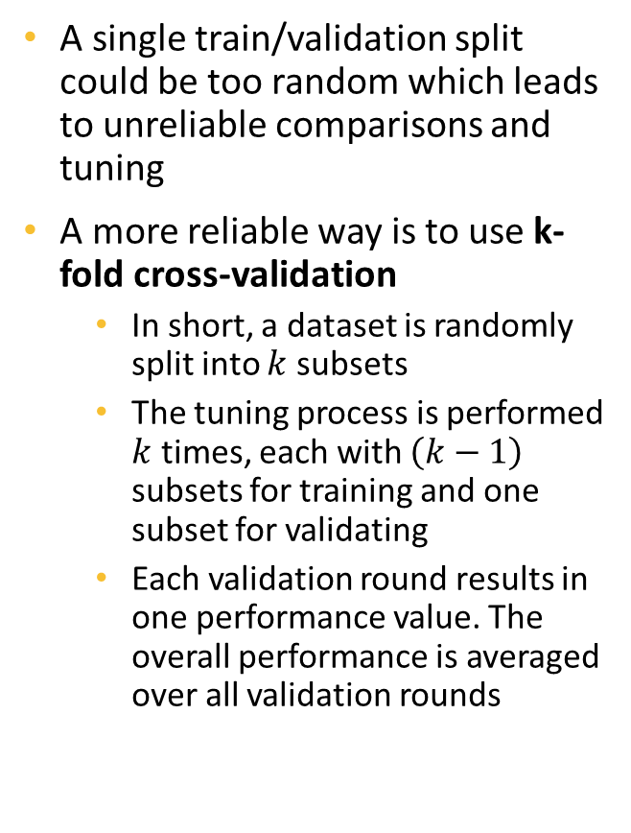



K-Fold Cross-Validation
Model training and validation
subset 2
subset 3
subset 4
subset 1
$$Accuracy_{1}$$
A single train/validation split could be too random which leads to unreliable comparisons and tuning
A more reliable way is to use k-fold cross-validation
In short, a dataset is randomly split into $k$ subsets
The tuning process is performed $k$ times, each with $\left(k−1\right)$ subsets for training and one subset for validating
Each validation round results in one performance value. The overall performance is averaged over all validation rounds
subset 1
subset 3
subset 4
Averaging
subset 2
$$Accuracy_{2}$$
All Data
subset 1
subset 2
subset 3
subset 4
$Accurac$y
subset 1
subset 2
subset 4
subset 3
$$Accuracy_{3}$$
Random split into 4 subsets
subset 1
subset 2
subset 3
subset 4
$$Accuracy_{4}$$
Training
Data
Validation
Data
Validation
Accuracy
4-Fold
Accuracy

Slide 12
Grid Search
Usually, a model has more than one hyperparameter that needs tuning. In a grid search, each hyperparameter is provided with a list of values
Each set of hyperparameter values then form a model to be tested and validated
The hyperparameter set that yields the highest validation score is considered the best one and is selected to apply on testing data
Max Depth | 2
Max Features | 5
Max Depth | 2
Max Features | 7
Max Depth | 2, 3
Max Features | 5, 7
Max Depth | 3
Max Features | 5
Hyperparameter
Grid
Max Depth | 3
Max Features | 7
Model to validate

Slide 13
Regularization
Training Data
Testing Data
y
More complicated models usually can learn more patterns in training data
That also means they are more vulnerable to overfitting
Regularization is one method to prevent a model from becoming too complicated
It prevents the coefficients of a model from becoming too extreme
Most models in scikit-learn has a hyperparameter for regularization and needs finetuning
Simple
Model
x
y
Complex
Model
x

Slide 14
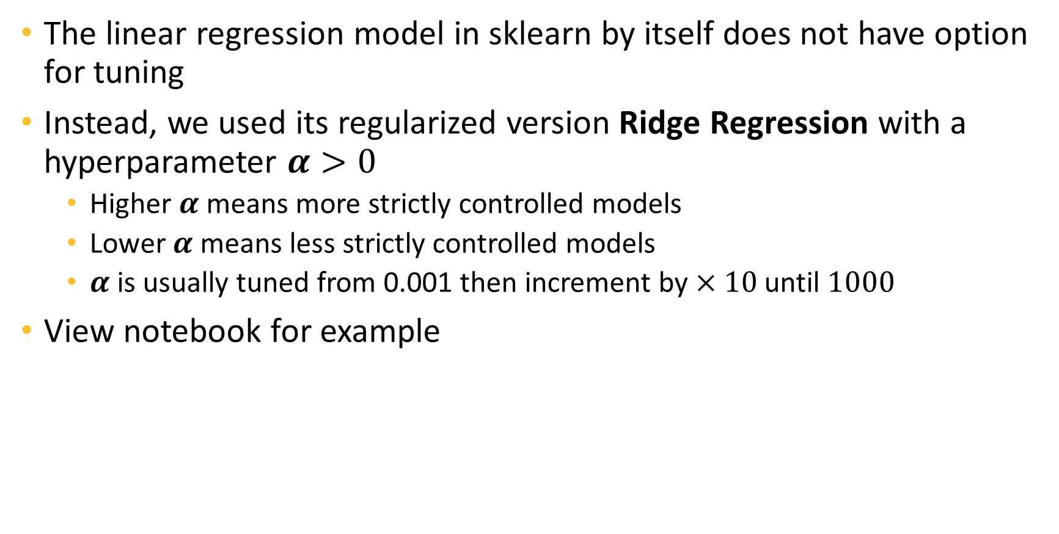
Tuning Linear Regression
The linear regression model in sklearn by itself does not have option for tuning
Instead, we used its regularized version Ridge Regression with a hyperparameter $α>0$
Higher $α$ means more strictly controlled models
Lower $α$ means less strictly controlled models
$α$ is usually tuned from 0.001 then increment by $×10$ until $1000$
View notebook for example

Slide 15

Tuning Logistic Regression
Very similar to Linear Regression, we need to finetune the hyperparameter $C>0$ that controls how strict the regularization is
Higher $C$ means more strictly controlled models
Lower $C$ means less strictly controlled models
$C$ is usually tuned from 0.001 then increment by $×10$ until $1000$

Slide 16
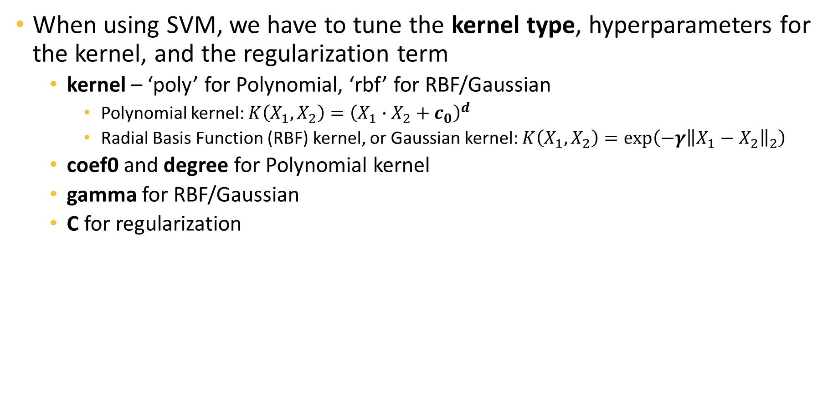
Model Tuning for Support Vector Machine
When using SVM, we have to tune the kernel type, hyperparameters for the kernel, and the regularization term
kernel – ‘poly’ for Polynomial, ‘rbf’ for RBF/Gaussian
Polynomial kernel: $K\left(X_{1},X_{2}\right)={\left(X_{1}∙X_{2}+c_{0}\right)}^{d}$
Radial Basis Function (RBF) kernel, or Gaussian kernel: $K\left(X_{1},X_{2}\right)=\exp\left(−γ{\left\|X_{1}−X_{2}\right\|}_{2}\right)$
coef0 and degree for Polynomial kernel
gamma for RBF/Gaussian
C for regularization

Slide 17
Model Tuning for Decision Tree and Random Forest
Main hyperparameters to be finetuned for a tree:
max_depth: maximum depth of the tree. The tree on the right has a depth of 3. Depth represents the maximum distance (number of paths) between the root node and a leaf node.
min_samples_split: minimum number of instances required to split an internal node. For example, if the number of instances ending up in the TaxInc is smaller than the min_sample_split, the node will not be split further
min_samples_leaf: minimum number of samples required to be at a leaf node. A split point will only be considered if it leaves at least min_samples_leaf training instances in each of the left and right branches.
max_features: maximum number of features to consider when looking for the best split
max_leaf_nodes: maximum number of leaf nodes over the whole tree
Random forest has all hyper-parameters of decision tree, with an additional one:
n_estimators: number of trees to fit

Slide 18
AWS SageMaker Models

Slide 19
Extreme Gradient Boosting (XGBoost) Model
Fitting and selecting best tree
An ensemble of tree models similar to Random Forest
Unlike random forest, the trees are not added to the ensemble randomly but rather with an objective of minimizing the training errors
Is trained iteratively, starting from an empty ensemble
Fit many trees on the training data
Select the one with the best performance to add to the ensemble
Repeat until having the desirable number of trees
Provided in AWS SageMaker for both regression and classification
X1 | x2 | x3 | y
Iteration 1
Data
Iteration 2
Fitting and selecting best tree
Final ensemble
Iteration n
…

Slide 20
XGBoost Model
Some hyperparameters are similar to that of Random Forest. Need to be tuned using AWS jobs. Main parameters to optimize are
Hyperparameter | Description | Note
alpha | Regularization term | Similar to C in other models
eta | Decide how fast the model is trained
max_depth | Maximum depth of each tree | Similar to max_depth in decision tree
num_round | Number of rounds to run training
subsample | Subsample ratio of the training instance. Setting it to 0.5 means that XGBoost randomly collects half of the data instances to grow trees. This prevents overfitting.

Slide 21
SageMaker Linear Learner
Is an automated and generalized linear model that is available in AWS SageMaker
Depending on the given task, will be
An advance linear regression model for regression
An advance Logistic regression model for binary classification
Other models for other tasks are also available

Slide 22
Hyperparameters of Linear Learners
“l1”: for type-1 regularization
“wd”: for type-2 regularization
“mini_batch_size”: size of mini-batch data to train the model
The training data is subset into multiple batches to input to the model
This hyperparameter decides how many instances to feed the model at a time
“learning_rate”: decide how fast model training is

